Slide 1
Mac users
PC users
Please sit together on this side of the room
Please sit together on this side of the room
Everyone
Please connect to the wifi
Create a new folder named “vagrant” on your desktop
Copy contents of flash drive to this folder
Notes:
Take an OS survey by show of hands

Slide 2
There’s an API for That
MARAC
April 20th, 2017
Lora J. Davis
Valerie Addonizio
Johns Hopkins University

Slide 3
Introduction

Slide 4
Workshop aims
1.
Practical, real life application
Info-packed take-home
Resource-packed GitHub
2.
Assurances:
You are not alone
I didn’t get into this field for this either (but some of you may have!)
This is difficult and frustrating
You didn’t miss a flight; the airport turned into a space launch while you were in the parking lot
Notes:
Valerie

Slide 5

The 1-up learning experience
You can’t learn it all and we can’t teach it
Are you a 1?
We hope you’ll leave a 2.
Are you a 2?
We hope you’ll leave a 3.
Are you a 3?
We hope to give you new ideas, scripts, and momentum.
Notes:
Valerie

Slide 6


The Odd Couple
We are stronger and smarter together
Lora
Valerie
Digital Archivist
Never met a task she didn’t want to solve with Python/Ruby
Thinks hanging with the Bmore on Rails group sounds like a fun night out
Helped migrate two institutions to ArchivesSpace and found it thrilling
Enjoys craft beer, cross stitch, and the Pittsburgh Steelers
Knows how to programmatically manipulate data
CATS YAY!
(Former) Photo Archivist
Never met a task she didn’t want to solve with an MS Access database
Knows rails are either “narrow gauge” or “standard” because ❤ steam trains
Helped migrate to ASpace and felt like a fish climbing a tree
Enjoys geocaching, hiking, and planning ambitious camping trips
Knows data modeling and systematic analysis of the really hard problems
CATS YAY!
Notes:
Both (mainly Valerie)

Slide 7
What does API stand for?
Application
As in a computer application, like Word or Chrome
Programming
As in computer “programming,” or taking steps to make a computer do something you want it to do
Interface
As in the the place where two systems meet
Notes:
Lora

Slide 8
What do APIs do?
As the prior slide suggests, APIs make it possible for applications to interact (or interface) with one another.
APIs are not new, and there are many types of APIs.
When you copy content from a Word document to your clipboard, then paste that content into an Outlook e-mail, it works because your computer operating system, which both your versions of Word and Outlook are programmed to run on, uses an API to allow the interchange of information.
APIs tell software developers the rules of the road that they must follow if they want their applications to play well with others.
For more: http://readwrite.com/2013/09/19/api-defined/
Notes:
Lora

Slide 9
That’s not at all what I thought an API was!
Though anything that allows an interchange of information between two applications is technically a form of an API, what we typically mean today when we say “API” is a very specific thing.
That thing is a web API.
Notes:
Lora

Slide 10
Ok, so what is a web API?
Complicated: A RESTful API is an application program interface (API) that uses HTTP requests to GET, PUT, POST and DELETE data.
For more: http://searchcloudstorage.techtarget.com/definition/RESTful-API
Simple: You access it over the web, using URL-like directions, and are limited to 3-4 simple commands or activities.
Extra nerdy sidebar:
Web APIs also come in several flavors, including SOAP and REST.
We’re going to be exclusively working with RESTful APIs today, as they’re far more prevalent in archives/libraries technologies.
REST stands for “representational state transfer” and was defined in 2000 in a doctoral dissertation by Roy Fielding.
REST essentially dictates how an application should be able to textually interact with a web service.
Notes:
Lora

Slide 11
Vocabulary pitstop: API Terms
GET, POST, and DELETE are the three cornerstone commands for a RestfulAPI
We will use these terms throughout
Think of them as View, Save, and of course, Delete
All APIs allow GETs, some let you POST, and few allow you to Delete
ASpace does all three, but allows you to tailor permissions for each
Notes:
Valerie

Slide 12
I’m not an application, I’m an archivist! Why should I care?
As librarians and archivists with collection descriptions and/or collections themselves on the web, you probably do care about being able to access and meaningfully manipulate textual data on the web at scale.
In many of the exercises we will work through together today, you are, in fact, one of the “applications” interfacing with web-based data.
Notes:
Lora

Slide 13
API Possibilities
Get data out
Do something to it
Put it back in
Access
OpenRefine
XSLT
Custom script (your choice)
Find and Replace
Hand encoding, copy and pasting, glue and popsicle sticks, whatever it takes!
*needle coming off the record*
This is the tough part.
JSON
MARC21
Any standardized data
Notes:
Valerie

Slide 14
Questions???
Notes:
Both

Slide 15
Setting up your tech: A long-ish pitstop
(We promise you’re in the right workshop)
Notes:
Lora

Slide 16




Technical pitstop:
The (FREE) Applications
Atom
A text editor that is handy for interacting with JSON, scripts, and all sorts of structured data
Can utilize additional packages to customize to your needs (e.g. a JSON “linter”)
Postman
A GUI application for interacting with APIs
VirtualBox
A virtualization application that lets you run another machine (a “guest) within your existing computer (the “host”)
We’re not using this in this workshop other than as a dependency for Vagrant, but you should check it out!
Vagrant
A way to build and manage a virtual machine
We’re using it to set you all up with a test instance of ArchivesSpace
Notes:
Lora

Slide 17
Technical pitstop:
The Command Line
While this is NOT the purpose of this workshop, we need to pause to learn a few very quick things about navigating the command line
For a fuller introduction to navigating the command line, see: https://www.codecademy.com/learn/learn-the-command-line
Common commands we will use today:
up arrow - shortcut to repeat the last command
ls - “listing,” or “tell me what’s in this directory”
(Note: This works for Windows users today because we’re using a Unix emulator, Cygwin. Natively, Windows users should use “dir.”
cd - “change directory,” or “let’s move somewhere else”
pwd - “print working directory,” or “tell me exactly where I am”
Notes:
Lora, some live demo

Slide 18
Technical Pitstop:
Scripting set-up
Notes:
Lora

Slide 19
Technical Pitstop - Scripting set-up
We are about to:
Show you a quick shortcut
Get some important packages installed on your machines
Clone our GitHub repository (download some scripts to your computer)
Caveats:
This is scary, we will lose some of you
You do need to know this, but we have other tofu to fry
Use these slides if you need to set up your own workstations back at the office
There is some other advice and more in-depth walkthroughs in the take-home document
Housekeeping:
With 30 people in this class, we’ve got 30 different environments to troubleshoot and 30 different opportunities to fail - please be patient!
If, at any point for the remainder of the workshop, you need assistance, please place a hot pink post-it on the back of your laptop screen
Notes:
Valerie

Slide 20
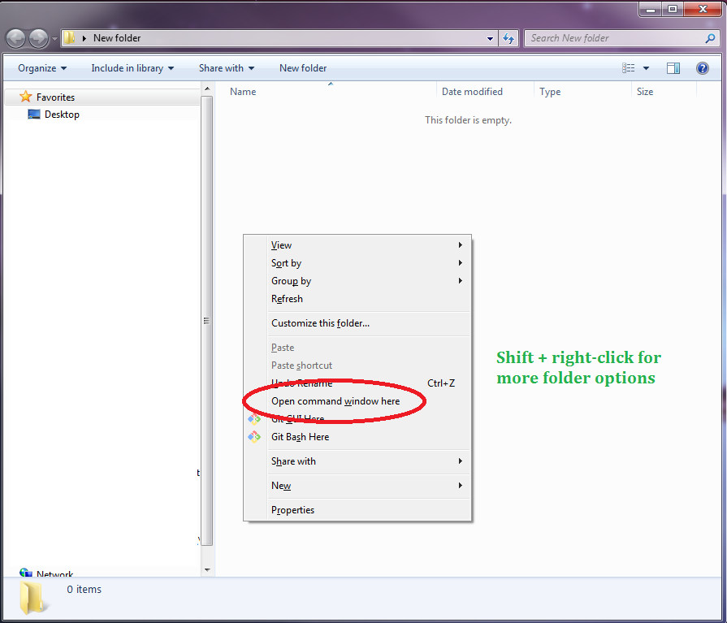
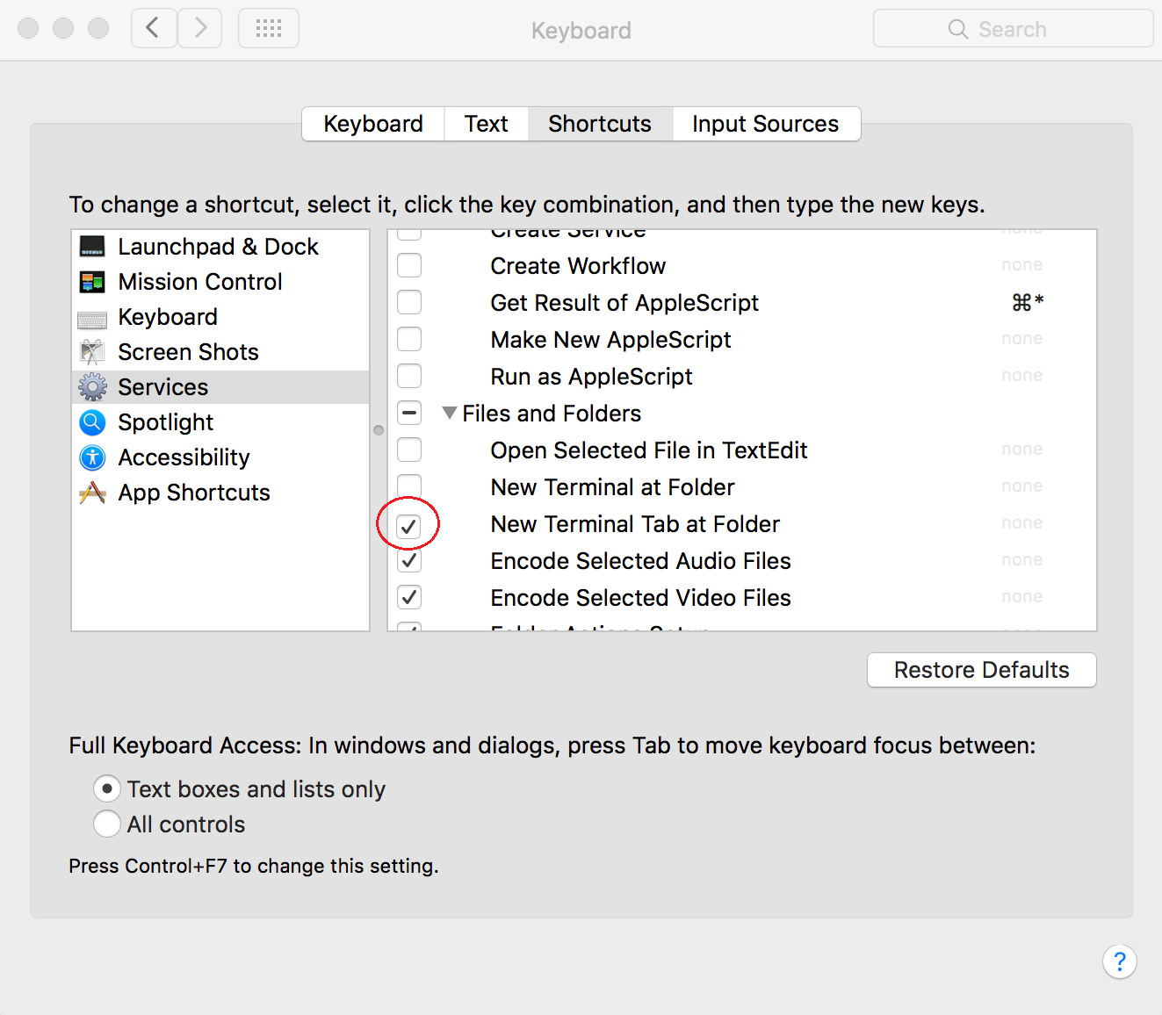
Technical Pitstop - Scripting set-up
Mac
PC
System Preferences > Keyboard > Shortcuts tab > Services
Shift + right click
Notes:
Lora

Slide 21


Technical Pitstop - Scripting set-up
Mac
PC
Please open the terminal:
Use spotlight search to search for “Terminal”
OR, open your Applications folder, then open the Utilities folder. Open the Terminal application.
Please navigate to http://cygwin.com/install.html
(that’s c-y-g-w-i-n)
Download and bring up the installer
Notes:
Lora mac; Valerie PC

Slide 22
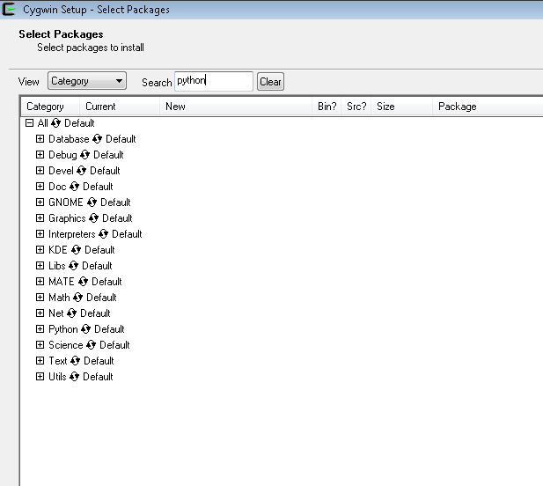
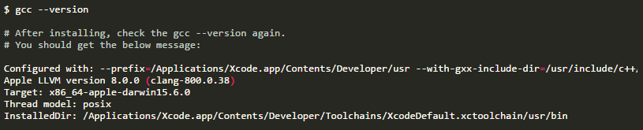
Technical Pitstop - Scripting set-up
Mac
PC
Type gcc --version and hit enter
If you are prompted to install, hit Install! Once complete, type gcc --version again.
If you see the following, you’re good to go. Leave the terminal open.
Start downloading. Say yes to everything
Pick any site to install from and continue
Stop when you get to this screen:
Notes:
Lora mac; Valerie PC

Slide 23
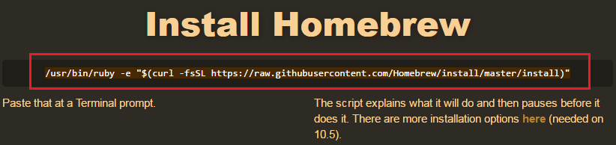
Technical Pitstop - Scripting set-up
Mac
PC
Open a browser and navigate to: brew.sh
(yup that’s a webpage)
Copy the long command and paste into terminal. Hit enter.
Enter your password if needed
Start downloading. Say yes to everything
Pick any site to install from and continue
Stop when you get to this screen:
Notes:
Lora mac; Valerie PC

Slide 24
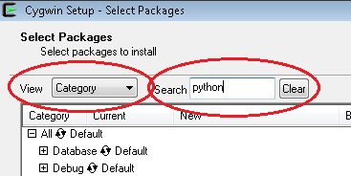
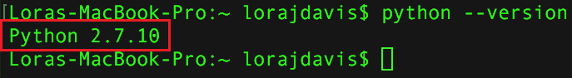
Technical Pitstop - Scripting set-up
Mac
PC
Type brew install python
Type python --version and be sure Python appears:
Type pip install requests
Look for this at the top
View: Category
Search for “python”
Notes:
Lora mac; Valerie PC

Slide 25
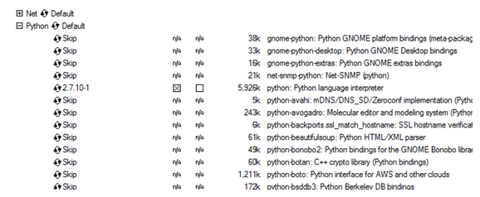
Windows users: Install packages
When you get to the Select Packages window, search for Python then unskip:
python2: Python 2 language interpreter 5,873k
python2-requests: Python HTTP/1.1 request module 84k
Search for git, expand Devel, unskip:
git: Distributed version control system 4,936k
Search for openssh, under Net, unskip:
openssh: The OpenSSH server and client programs 750k
Next > Next
Notes:
Valerie

Slide 26
Technical Pitstop - Scripting set-up
Everyone
Open Atom
Along the menu bar, select File > Settings > Install > Install Packages > search for “beautify” and install
Check that it installed under Packages in the menu bar
Notes:
Valerie

Slide 27
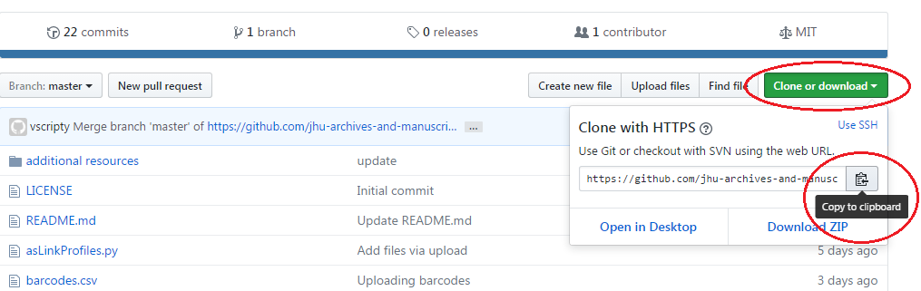
Technical Pitstop - Scripting set-up
Everyone
Navigate to GitHub.com
Search for “MARAC API Workshop”
Bookmark!
Then click green button, and copy the path to the clipboard
Notes:
Lora

Slide 28
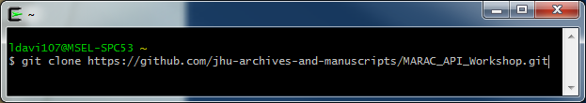
Technical Pitstop - Scripting set-up
Mac
PC
Ctrl+click on Desktop > New Terminal at Folder
Type git clone [ctrl-click > paste]
Open cygwin
Type git clone [right-click > paste]
Now you have a folder (either on your Desktop, or in your Cygwin home directory) that contains all the materials you’ll need for the rest of today’s workshop.
This folder, titled “MARAC_API_Workshop,” is a direct clone of what you see in your browser on github.com.
Notes:
Lora

Slide 29

Notes:
Both

Slide 30
15 minute break!

Slide 31
GET
Notes:
Valerie

Slide 32
API possibilities
Get data out
Do something to it
Put it back in
We are here
Notes:
Valerie

Slide 33
GET with GUI - ProPublica
Notes:
Valerie

Slide 34
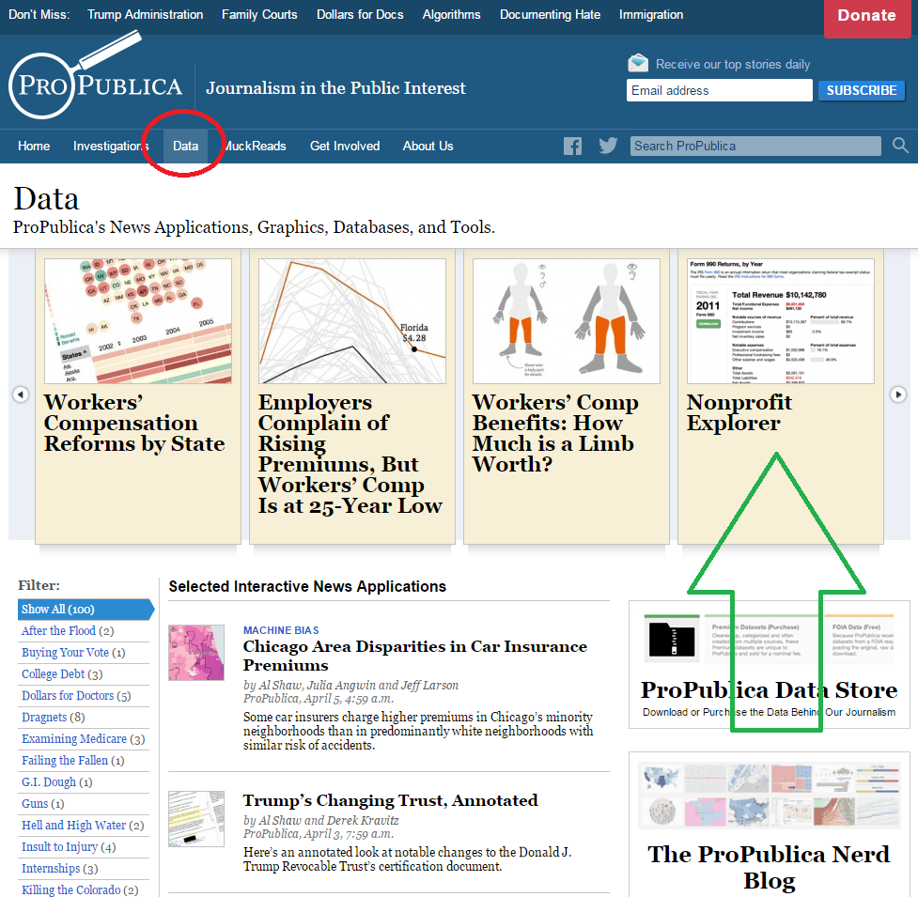
GET through a GUI
Scenario: A user wants access to data about every non-profit involving animal welfare in Nonprofit Explorer at ProPublica.
ProPublica.org is a research-based journalism site that provides its data to other reporters and the public
Navigate to ProPublica.org
Click Data
Click Nonprofit Explorer
Do a search for “animal,” which will bring up a list of animal-based charities
Look at the address bar
Notes:
Valerie

Slide 35
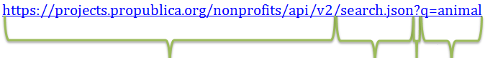
https://projects.propublica.org/nonprofits/api/v2 | The address of the API. All requests must start with a similar string in order to point the request to where it needs to go. It essentially reads: go here.
/search.json | The search method set by the API. By appending this to the above URL, it essentially reads: go here, search, output that search in JSON.
? | Question marks denote that whatever follows is a parameter. Adding this to the above essentially reads: go here, and search, and use the following parameters. You can use more than one parameter.
q= | The parameter. The ProPublica API defines q as “A keyword search string. Searches using this parameter will search (in order) organization name, organization alternate name, city.”
animal | Any keyword supplied by the user. Go here, and use the keyword search parameter to search for animal, which will output as JSON.
ProPublica API documentation: https://projects.propublica.org/nonprofits/api
Notes:
Valerie

Slide 36
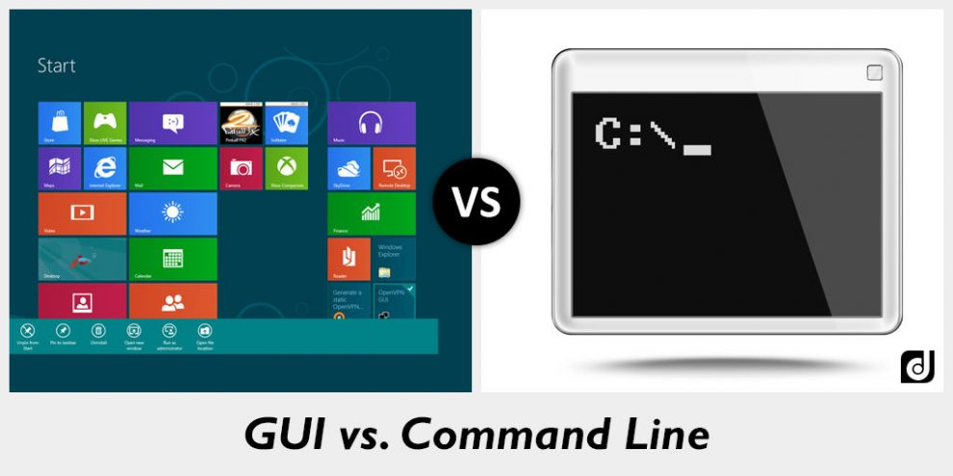
Vocabulary pitstop:
GUI
GUI (gooey) stands for Graphic User Interface: every program you use has a GUI
But in the programming/scripting world, there is also the command line/terminal
We will be using both: Postman is a GUI
Image from http://www.differencebtw.com/difference-between-gui-and-command-line/
Notes:
Valerie

Slide 37
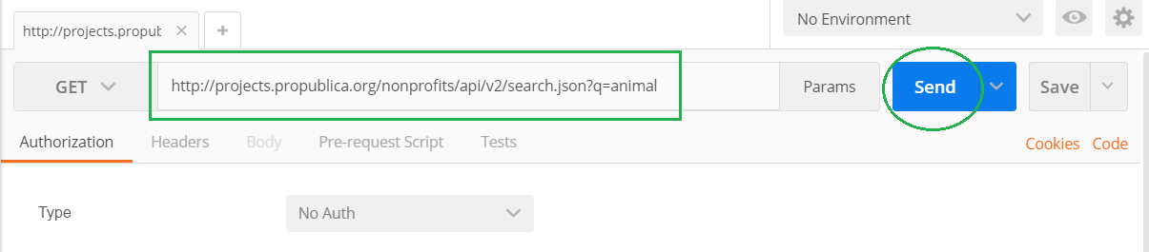
GET through a GUI
http://projects.propublica.org/nonprofits/api/v2/search.json?q=animal
Notes:
Valerie

Slide 38
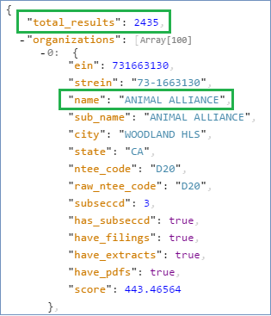
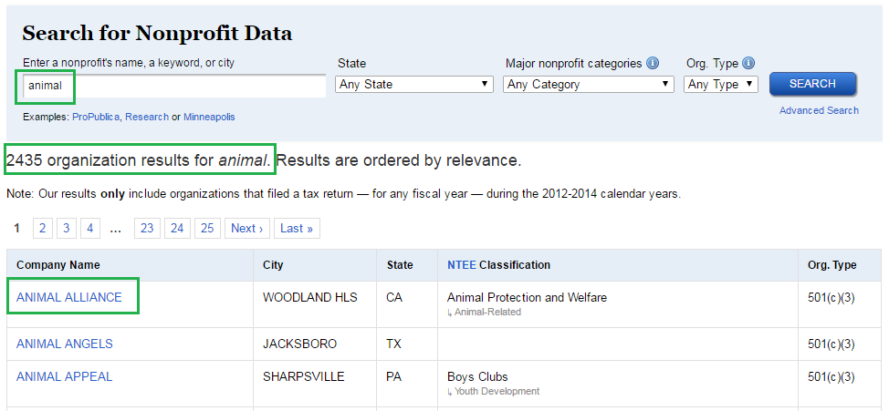
Web search versus API
You don’t get different results, you get the same results in a different format.
Notes:
Valerie

Slide 39
Vocabulary pitstop:
JSON
JSON (jason) is the most typical data transmission standard in APIs
It is lightweight and easy to read and NOT scary
Consists of key-value pairs, “key”: “value”
<unittitle>Johns Hopkins University library records</unittitle>
“Title”: “Johns Hopkins University library records”
Notes:
Valerie

Slide 40
Questions???
Notes:
Valerie

Slide 41
GET with GUI - Chronicling America
Notes:
Valerie

Slide 42
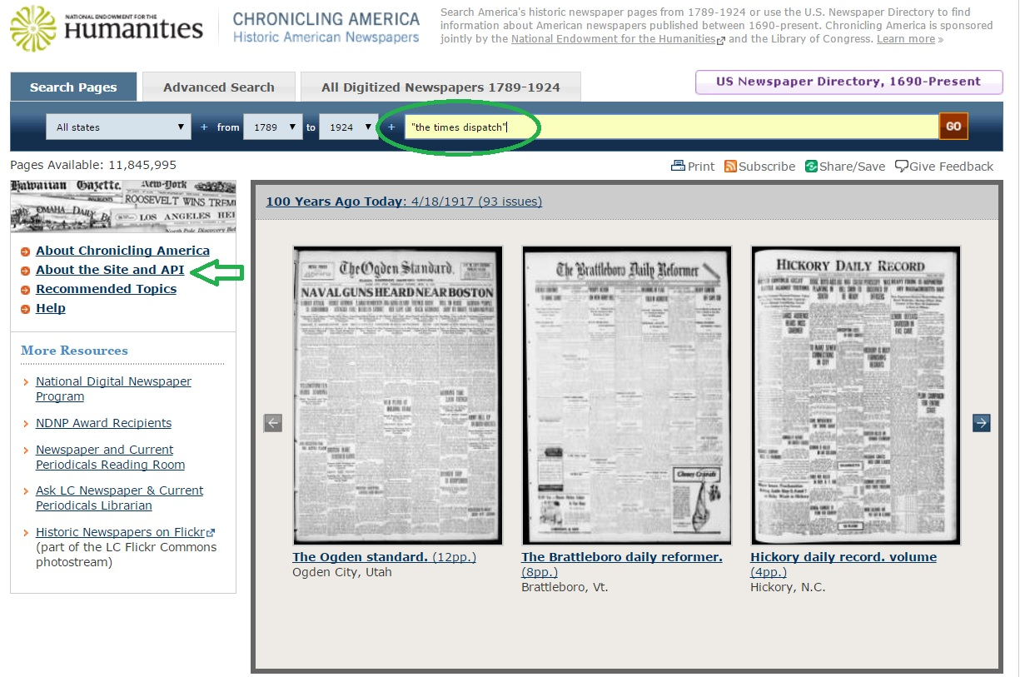
Web search versus API
Scenario: You wish to link to every digitized edition of a certain newspaper hosted in Chronicling America.
Navigate to ChroniclingAmerica.loc.gov
Search for “the times dispatch” in quotes
Notes:
Valerie

Slide 43
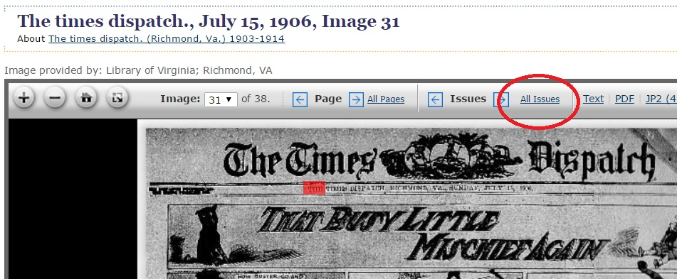
Web search versus API
Scenario: You wish to link to every digitized edition of a certain newspaper hosted in Chronicling America.
Click any record
Click All Issues
Notes:
Valerie

Slide 44
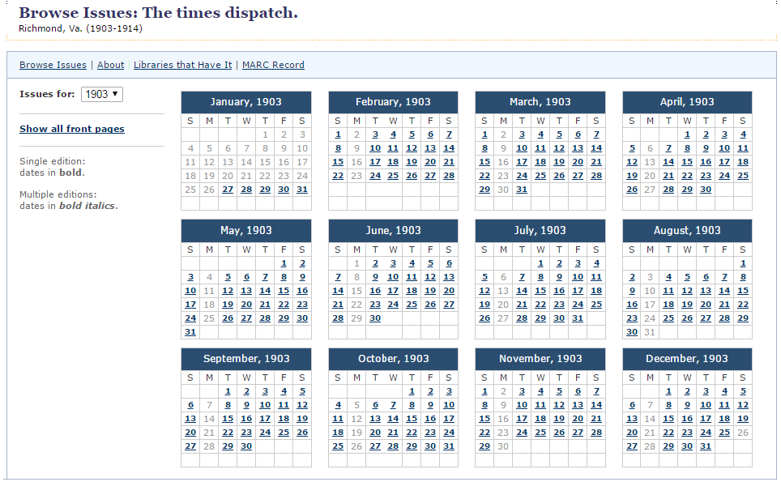
Web search versus API
This is not that helpful. I wonder if there’s another way! Is there an API for this?
Notes:
Valerie

Slide 45
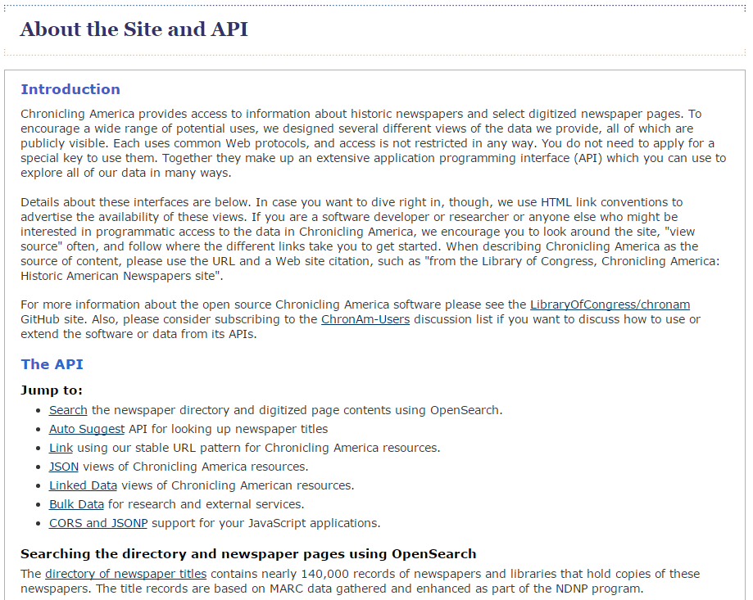
Web search versus API
Does Chronicling America have an API we can use to access this information we’re seeing in our browsers?
YES!
Back to Postman!
Notes:
Valerie

Slide 46
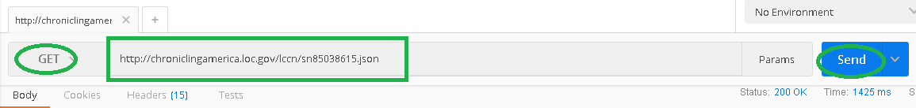
Web search versus API
Scenario: You wish to link to every digitized edition of a certain newspaper in Chronicling America.
http://chroniclingamerica.loc.gov/lccn/sn85038615.json
Notes:
Valerie

Slide 47
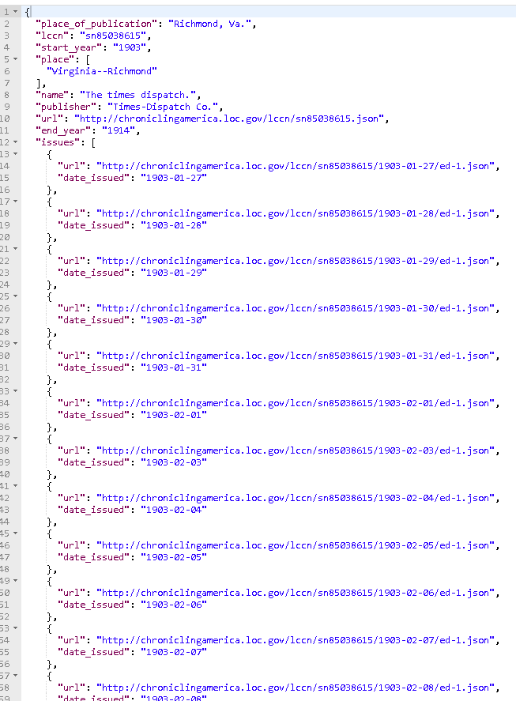
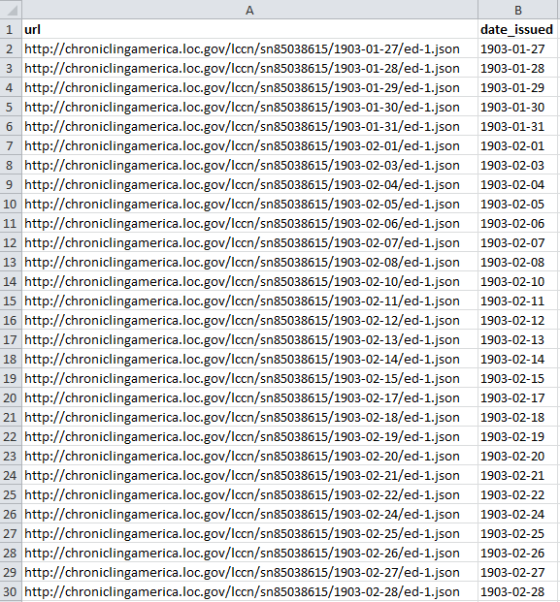
Re-purposing API data
Converting these JSON search results to a CSV (spreadsheet) took less than 10 seconds.
Notes:
Valerie

Slide 48
Questions???
Notes:
Valerie

Slide 49
GET with GUI - Twitter
Notes:
Lora

Slide 50
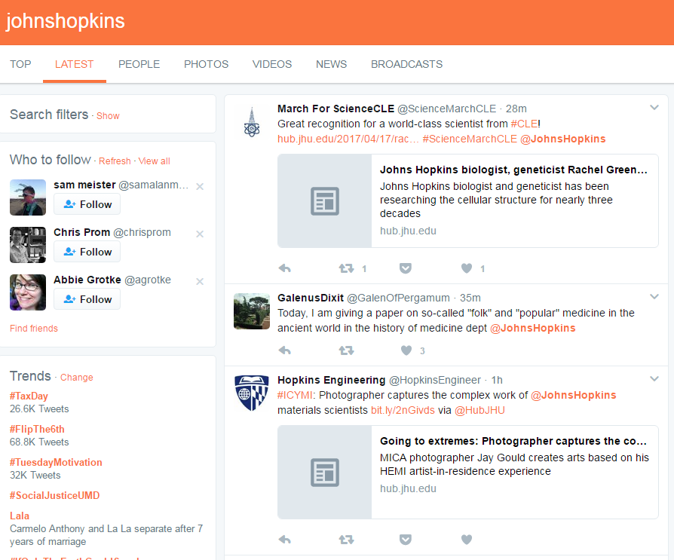
Using an API to collect records
Scenario: As your university’s records manager, you wish to regularly capture Tweets mentioning your university.
Notes:
Lora

Slide 51
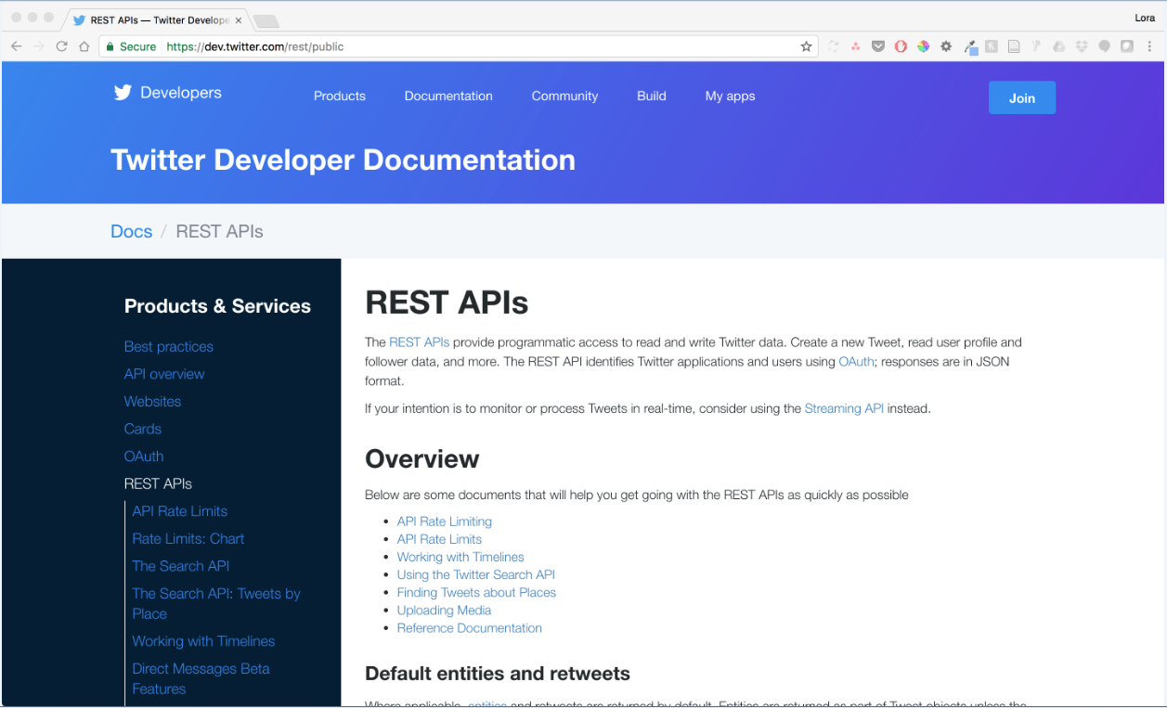
Using an API to collect records
Notes:
Lora

Slide 52
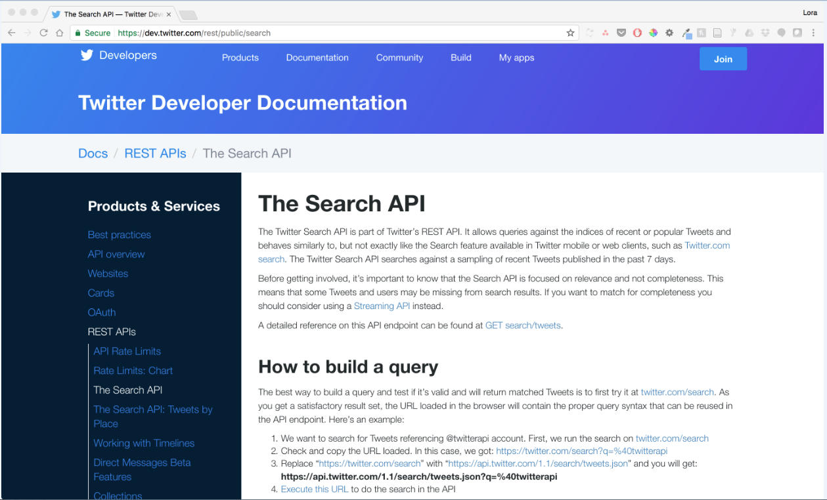
Using an API to collect records
Notes:
Lora

Slide 53
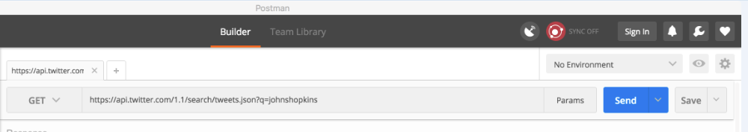
Using an API to collect records
https://api.twitter.com/1.1/search/tweets.json?q=johnshopkins
Let’s give it a try!
Notes:
Lora

Slide 54
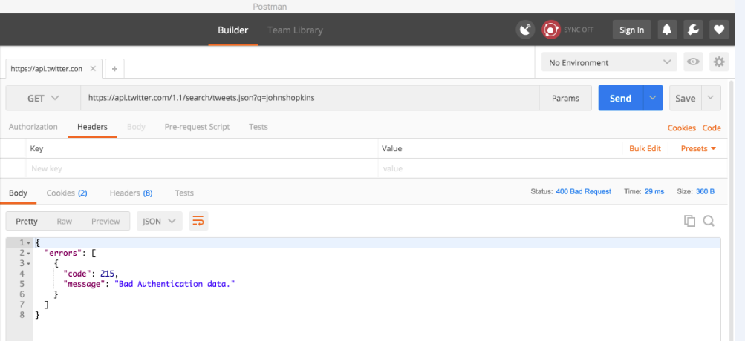
Using an API to collect records
Notes:
Lora

Slide 55
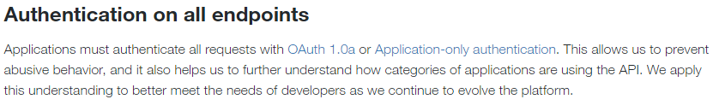
Using an API to collect records
Source: https://dev.twitter.com/rest/public
Notes:
Lora

Slide 56
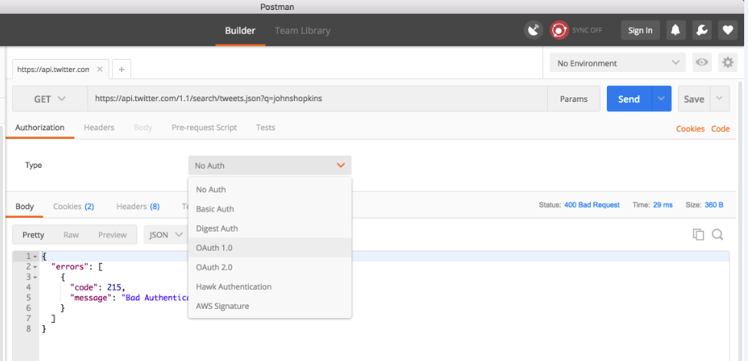
Using an API to collect records
So, we must authenticate in order to use Twitter’s search API.
The type of authentication Twitter requires is OAuth, an open protocol for authentication (see: https://oauth.net)
Postman will help walk us through OAuth1.0 authentication, but you must have a Twitter developer account in order to do so!
Show and tell!
Notes:
Lora
Live demo

Slide 57
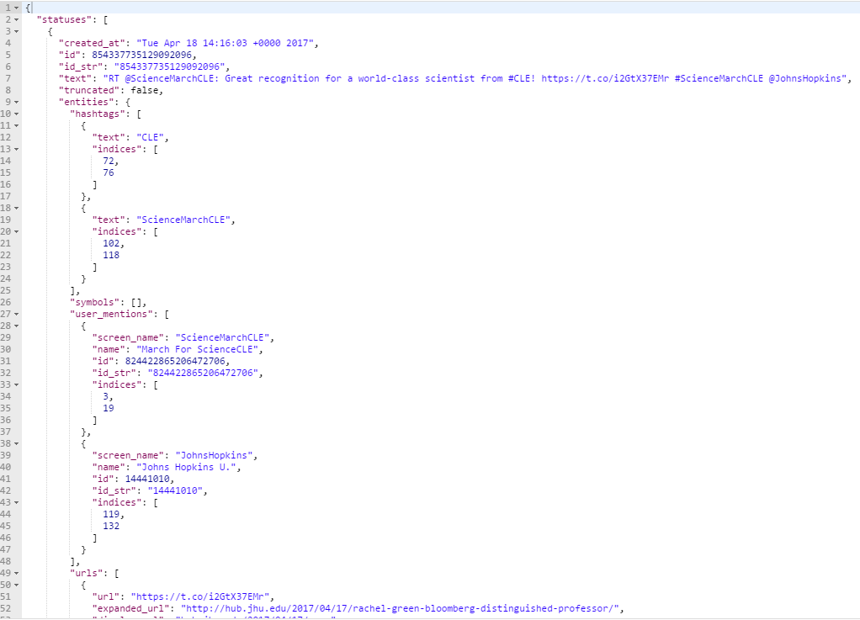
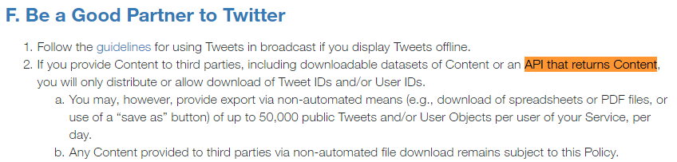
Using an API to collect records
In the end, we’ve got JSON. Though, be wary of the Twitter developer license you signed!
Notes:
Lora

Slide 58
Questions???
Notes:
Valerie

Slide 59
Scripting
Notes:
Lora

Slide 60
Scripting - Why?
Using a GUI application like Postman to interact with APIs can be a great way to learn, explore, and troubleshoot, but ultimately you’ll hit a brick wall, because:
It takes an awful lot of clicks to get out a small amount of data (relatively speaking)
If you want to get multiple full records OUT you’ve got to run a GET as many times as there are records you want to retrieve
While you can POST many one-off changes using a GUI like Postman, you can rarely get a GUI to make intelligent, iterative POSTs at scale
Manually authenticating is a pain
Though we told you that you will be sometimes playing the role of “application” in this API world, you don’t always want to be the application!
Notes:
Lora

Slide 61
Scripting - How?
Yes, this is a huge barrier to entry for most users, but it can be mitigated:
We (defined here as both archivists and developers) are a community that likes sharing!
Frankly, if you’re sitting down to write scripts from scratch, you’re doing it wrong
There is no “one right language” to make this work
If you have any prior knowledge of a particular scripting language, start there
All the scripts you will use in this workshop are Python because: 1) Python (and, to a lesser degree, Ruby) is Lora’s preferred hammer, and 2) unscientifically speaking, it seems that Python is the preferred language of archivists (which means there’s more to steal borrow)
But, if you want, you can use a Ruby or Perl or PHP or JavaScript shaped hammer!
The Internet is full of helpful advice!
Just don’t feed the trolls
Notes:
Lora

Slide 62
Scripting - No, really, how?
Remember all the legwork you did both at home and during the early part of this workshop? You’ve:
Installed applications, including the text editor Atom
Installed (or located) a shell, namely Terminal (Mac) or Cygwin (Windows)
Installed (or confirmed installation of) python
Guess what? You’ve set up a python development environment already! Good work!
With that work complete, for the remainder of this workshop you should only need to type python [name of script here].py into Terminal/Cygwin, and you’ll be executing Python scripts! Just remember:
You should be located in the same directory as the script (and any files it is reliant on) before you type your command (you can always ls to confirm the script is there!)
For more, see: http://www.shubhro.com/2014/05/29/development-environment/ and/or http://python-guide-pt-br.readthedocs.io/en/latest/starting/install/osx/ (Mac specific)
Notes:
Lora

Slide 63
GET with Script- ProPublica

Slide 64
GET with a script - ProPublica
Let’s return to our ProPublica example from earlier.
Scenario: A user wants access to data about every non-profit involving animal welfare in Nonprofit Explorer at ProPublica.
But, this time, let’s assume that this user isn’t content just copying/pasting pages of data out of Postman. This researcher has big plans for this dataset, and wants a standalone JSON file instead!
Scenario, v. 2: A user wants a JSON file containing ProPublica Nonprofit Explorer data about every non-profit involving animal welfare.
Notes:
Lora

Slide 65
GET with a script - ProPublica
Mac
PC
In the Finder navigate to your MARAC_API_Workshop directory
Ctrl+click the MARAC_API_Workshop directory, and select “New Terminal at Folder”
Type ls and examine the contents of that folder
Type python proPublica.py
A new file called “proPublicaRecord.json” should now be in your MARAC_API_Workshop directory
Open “proPublicaRecord.json” with Atom and take a look!
Open Cygwin
Type cd MARAC_API_Workshop to enter the MARAC_API_Workshop directory
Type ls and examine the contents of that folder
Type python proPublica.py
A new file called “proPublicaRecord.json” should now be in your MARAC_API_Workshop directory
Open “proPublicaRecord.json” with Atom and take a look!
Notes:
Lora mac; Valerie PC

Slide 66
Questions???
Notes:
Valerie

Slide 67
Load, GET, and compare - VIAF

Slide 68
API possibilities
Get data out
Do something to it
Put it back in
We are here
Notes:
Lora

Slide 69
Load, GET, and compare - VIAF
Scenario: You have an existing spreadsheet containing a number of organizational names that are either subjects or creators of some of your collections. Now, you want to take this manually-made spreadsheet and actually do some authority control work!
Notes:
Lora

Slide 70
Load, GET, and compare - VIAF
Open Excel/Numbers (or your preferred spreadsheet program)
Type “names” (lower-case) in the first column, first row
You can inspect the file “organizations.csv” in GitHub if you want to see a sample
Type several corporate names of your choosing (universities, businesses, etc.) in the subsequent rows of column A
Save the file as a .csv with the title “organizations.csv” in the MARAC_API_Workshop directory
Warning: You will be asked to overwrite an existing file named “organizations.csv” since we’ve saved a sample there as a just-in-case. Please overwrite this file.
From Terminal/Cygwin type python viafReconciliationCorporate.py
Notes:
Lora

Slide 71
Load, GET, and compare - VIAF
Uh oh...
Notes:
Lora

Slide 72
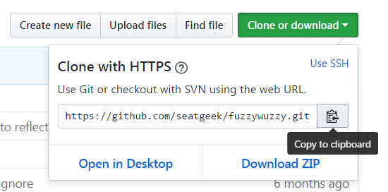
Technical Pitstop - Installing extra packages
Everyone
Downloading the fuzzy wuzzy python package:
Google “fuzzy wuzzy github” and it should be the first result
Click the green “Clone or Download” button, and copy the path to the clipboard
Confirm that terminal/cygwin is still in the MARAC_API_Workshop folder
Type git clone {paste path}, which should look like
git clone https://github.com/seatgeek/fuzzywuzzy.git
Notes:
Lora

Slide 73
Technical Pitstop - Installing extra packages
Everyone
Installing the fuzzy wuzzy python package:
Type cd fuzzywuzzy to enter the newly created fuzzywuzzy directory
Type ls to see what’s in the directory and note the script “setup.py”
To execute that setup script, type python setup.py install
The package is installed!
Type cd .. to return you to the MARAC_API_Workshop directory
Try the script again! python viafReconciliationCorporate.py
Notes:
Lora

Slide 74
Load, GET, and compare - VIAF
Let’s try this again!
Type python viafReconciliationCorporate.py
Success!
There is a newly created “viafCorporateResults.csv” file in your MARAC_API_Workshop directory
Let’s open and inspect it!
Notes:
Lora

Slide 75
Questions???
Notes:
Valerie

Slide 76
Lunch!

Slide 77
Technical Pitstop:
vagrant install and vagrant up
(this is super awesome)

Slide 78
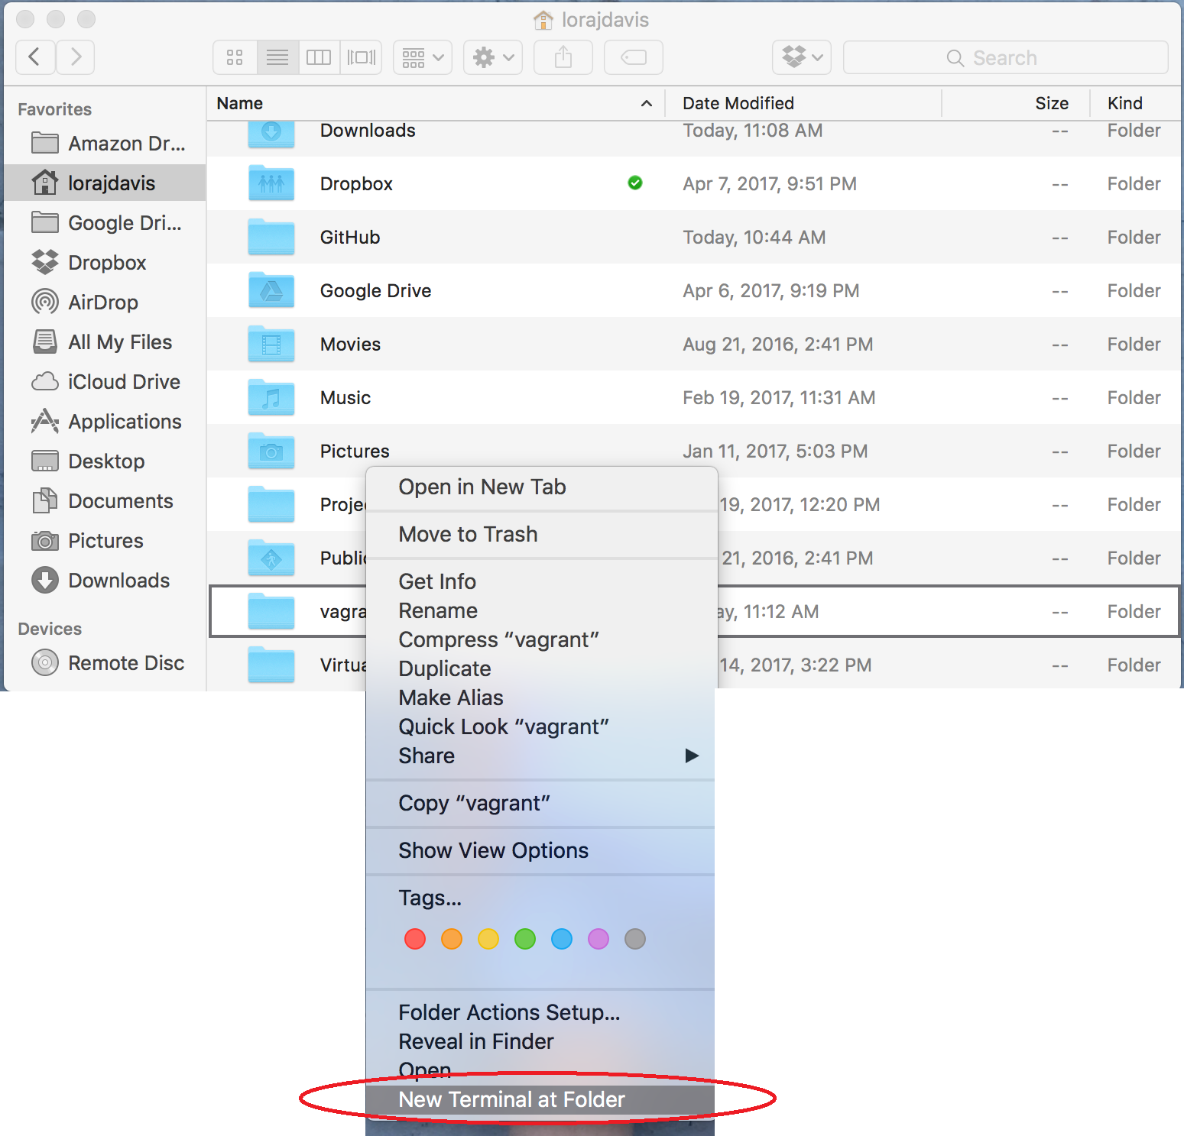
Mac
PC
Notes:
Lora Mac; Valerie PC

Slide 79
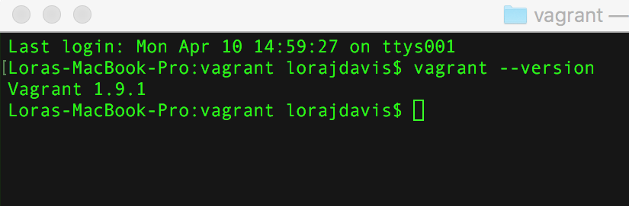
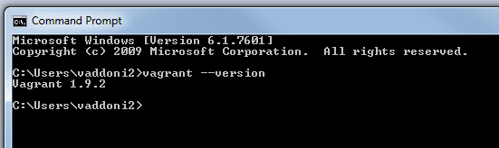
Technical Pitstop - Vagrant
Mac
PC
vagrant --version
If you see any number that doesn’t start with “1.9” or if you get an error altogether please use your post-its, or shout out!
Notes:
Lora

Slide 80
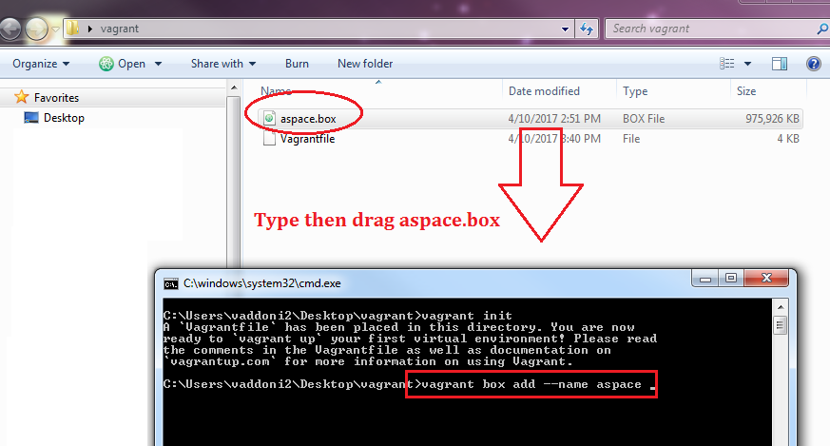
Everyone
vagrant box add --name aspace
Notes:
Lora Mac

Slide 81
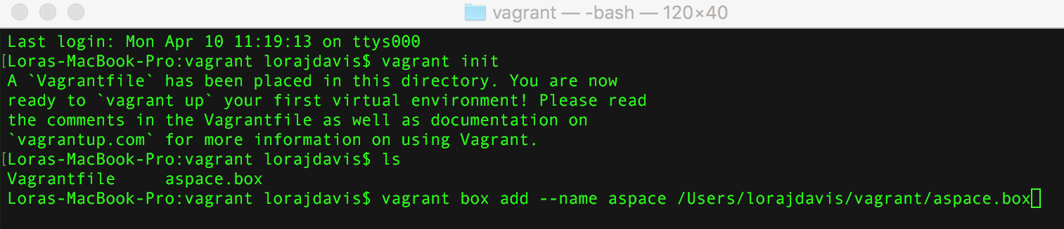
Everyone
It should look like this now:
Notes:
Lora

Slide 82
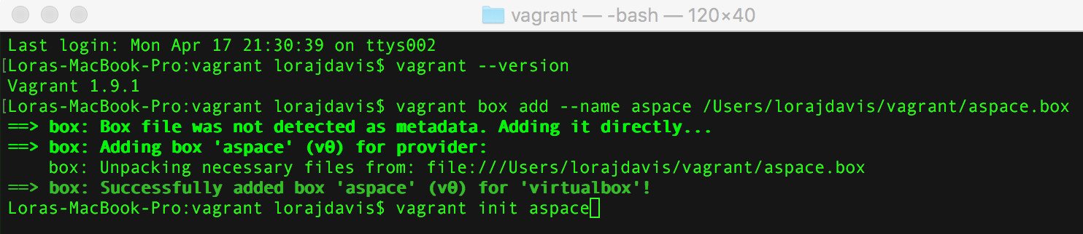
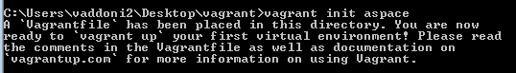
Technical Pitstop - Vagrant
Mac
PC
vagrant init aspace
Notes:
Lora Mac; Valerie PC

Slide 83
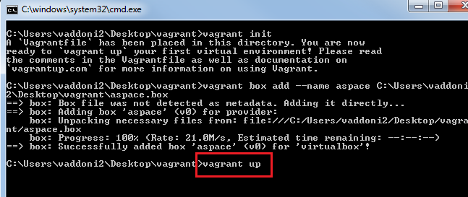
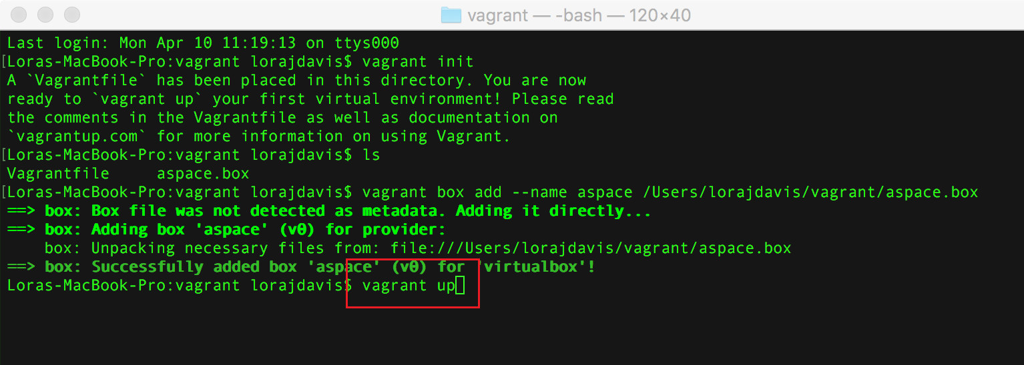
Technical Pitstop - Vagrant
Mac
PC
vagrant up
Notes:
Lora Mac; Valerie PC

Slide 84
Technical Pitstop - Vagrant
Open browser, navigate to:
http://localhost:8089
Notes:
Valerie

Slide 85
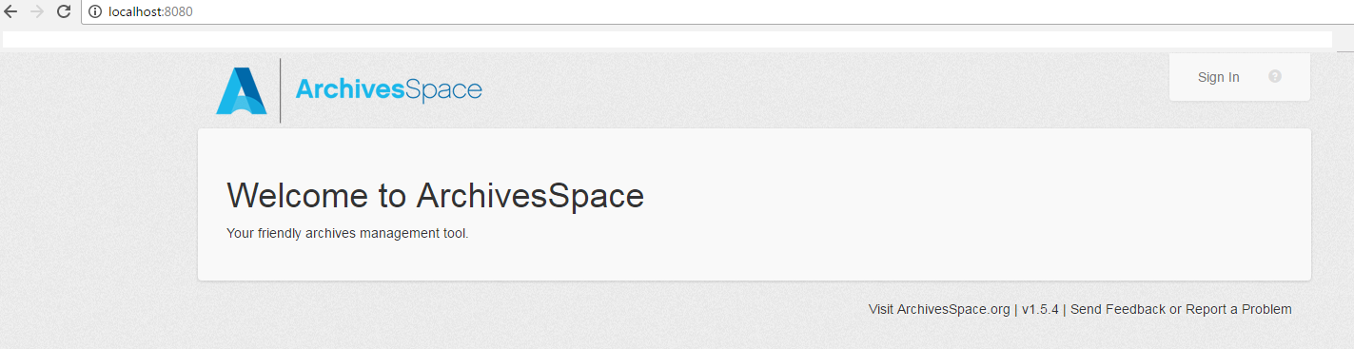
Technical Pitstop - Vagrant
Try: http://localhost:8080
Now you have a personal ArchivesSpace! It’s yours and it’s re-useable! Look around.
Username: admin
Password: admin
Notes:
Valerie

Slide 86
POST: ArchivesSpace
Notes:
Valerie

Slide 87
ArchivesSpace!
Scenario: You have successfully migrated into -- or have begun to use -- an instance of ASpace at your institution, but…
There’s all this new functionality, what do I do with it?
I don’t have barcodes for my containers, or I have faux codes
I do have barcodes, but they’re not in ArchivesSpace. How do I get them in without ruining a student worker’s semester?
There are new fields where there were no fields before
I’d love to use URIs for Agents, but that’s a lot of work
BARCODES, again with the barcodes
We didn’t use Archivists’ Toolkit for accessions, how do I get them in now?
Suppressing and unsuppressing, publishing and unpublishing, and how do I publish everything but not those things?
As some of you know, it’s a huge undertaking and you might have dozens/hundreds/thousands of old and new problems.
Notes:
Valerie

Slide 88
ArchivesSpace!
Scenario: You have successfully migrated into -- or have begun to use -- an instance of ASpace at your institution, but this is a short workshop, so here are our problems for today:
We don’t have container profiles in ArchivesSpace and would like to, so we need to create some
In following the migration instructions for 1.5, we had to add faux codes; we’d like to use our actual barcodes
Now that we have container profiles, we need to link them to actual top containers
Extra archivisty sidebar
These are, in fact, all problems we’ve addressed (or are addressing), at Johns Hopkins. And this is exactly how we did (or will be) solving these issues.
If you switch out "container profiles" for "agent records" or "subject headings" or “digital objects,” the steps are similar and will likely transfer. Namely:
Create new records
Modify existing records
Link records
Notes:
Valerie

Slide 89
POST to AS with GUI- Container profiles
Notes:
Valerie

Slide 90
API possibilities
Get data out
Do something to it
Put it back in
We are here
Notes:
Valerie

Slide 91
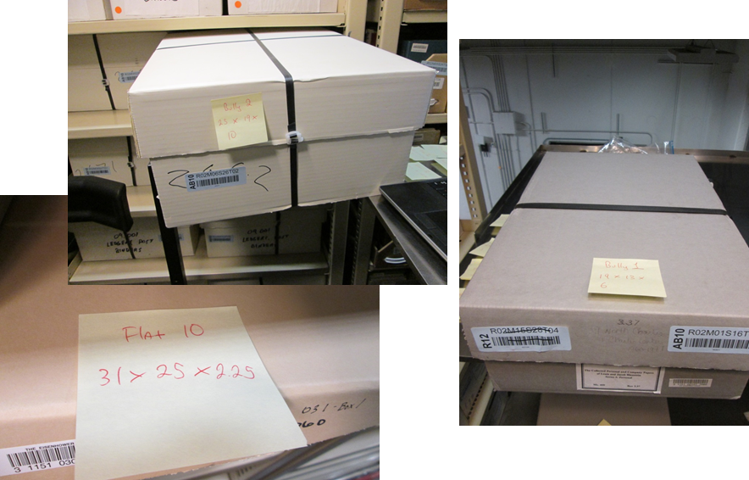
Container profiles
What’s a container profile?
ASpace offers “container modeling” for the first time in the archives world.
Every type of box (ex. record carton) in your library gets its own record (a profile), which records its height, width, and depth. This helps calculate space on a huge scale, and is a game-changer for some repositories.
So, we have boxes o’plenty --------------->
But to use this feature, we need to get their profiles into AS.
Notes:
Valerie

Slide 92
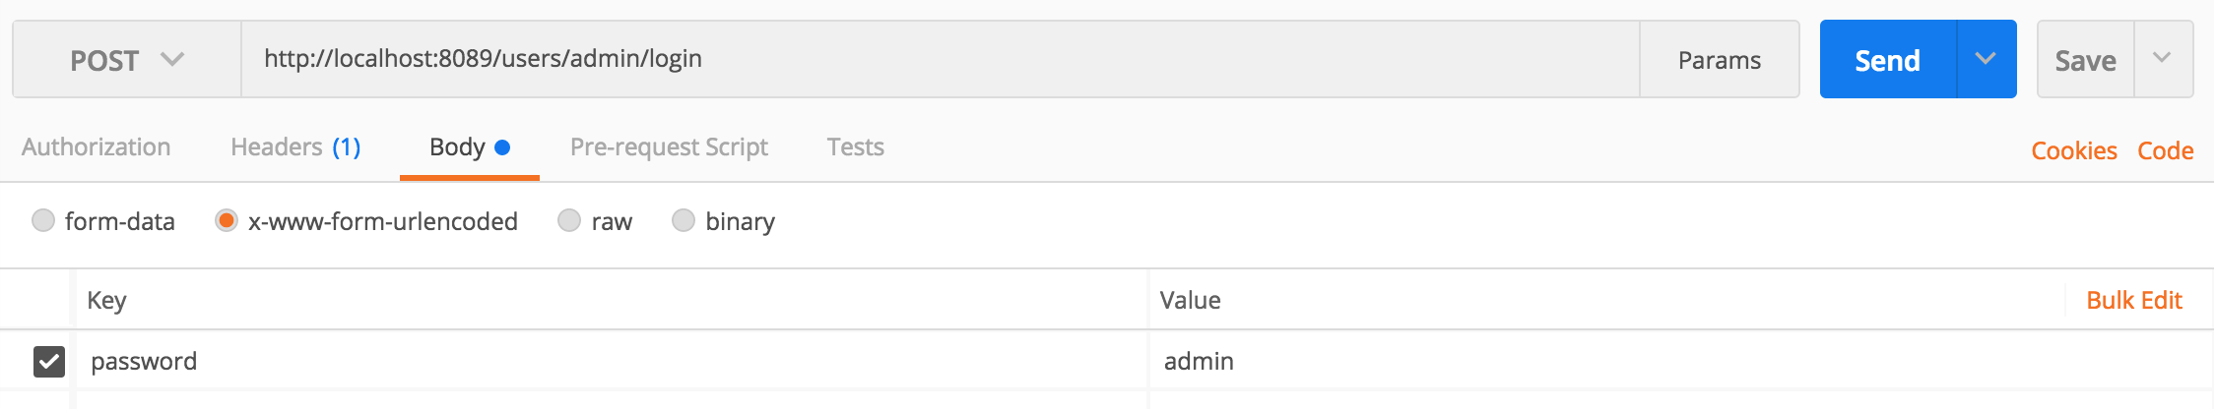
POST to AS with GUI
Before we start posting to AS, we need to authenticate, so let’s do that and try a GET first:
Endpoint: http://localhost:8089/users/admin/login
password=admin
Notes:
Valerie

Slide 93
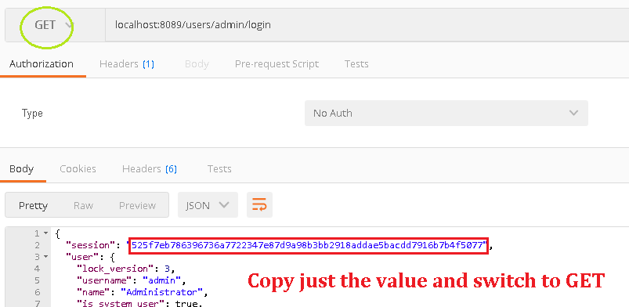
POST to AS with GUI
Notes:
Valerie

Slide 94
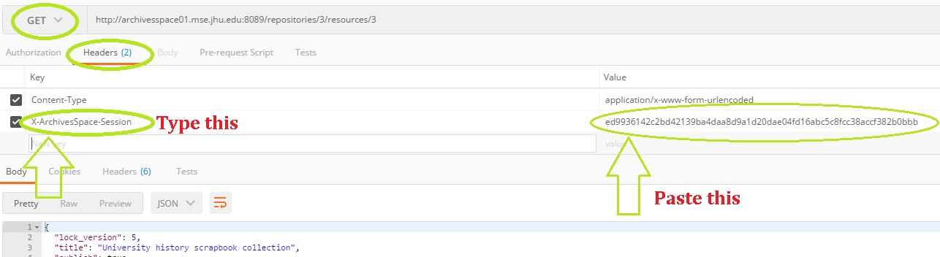
POST to AS with GUI
Key: X-ArchivesSpace-Session
Endpoint: localhost:8089/repositories/1/resources/1
Notes:
Valerie

Slide 95
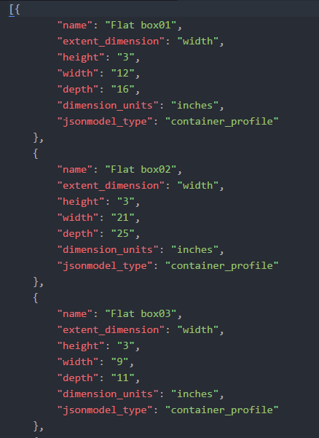
POST to AS with GUI - Container profiles
Navigate back to the directory with our cloned GitHub repo
Open containerProfiles.json
Here are the profiles, ready to go
Copy, and go back to Postman
Notes:
Valerie

Slide 96
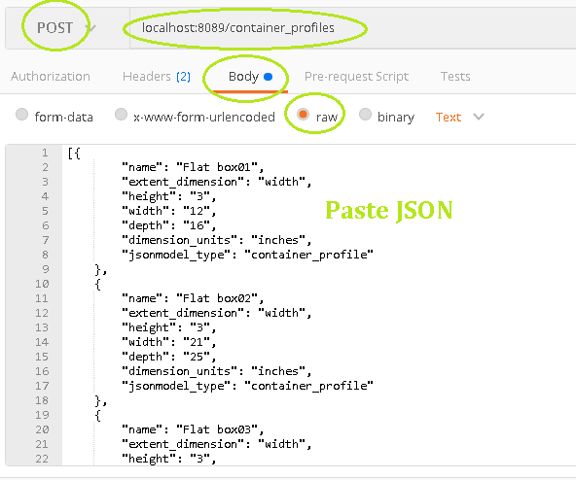
POST to AS with GUI - Container profiles
Endpoint: localhost:8089/container_profiles
Notes:
Valerie

Slide 97
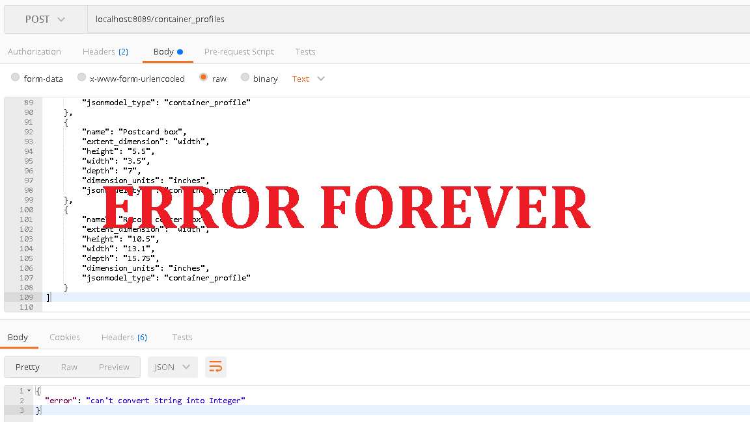
POST to AS with GUI - Container profiles
Don’t hate us: you cannot post multiple records through the GUI
This frustrating exercise will save you a month
(use your month wisely - take a vacation from ArchivesSpace)
Notes:
Valerie

Slide 98
Notes:
Both

Slide 99
POST to AS with script- Container profiles
Notes:
Valerie

Slide 100

POST to AS with script
Before we start posting to AS, we need to authenticate, so how do we do that with scripts?
Notes:
Valerie

Slide 101

POST to AS with script
“Keep it secret, keep it safe.” - Gandalf
This means no manual authenticating! Learn to script just for that and call it a win!
Notes:
Valerie

Slide 102
POST to AS with script- Edit barcodes

Slide 103

Barcodes/top_containers
Répète: ASpace offers “container modeling” for the first time in the archives world.
Every type of box (ex. record carton) in your library gets its own record (a profile), which records its height, width, and depth.
Every actual box in your collections also gets a record, and this is called a top container. Simply put, this is the thing you put a number on: Box 1.
So, your archives might have 2,563 boxes called “Box 1”
Barcodes make that sane for AS. Hence, AS 1.5 requires some sort of unique barcode on every top container.

Slide 104

Barcodes/top_containers
Every marathon runner and every top_container must have a unique ID to participate.

Slide 105
15 minute break!

Slide 106
GET and POST across two applications with Python
Notes:
Lora

Slide 107


App-to-app Communication
Scenario: As your university’s web archivist, you wish to make your Archive-It web crawls accessible to users who access your collections via ArchivesSpace without having to individually create digital objects every time you run a new Archive-It crawl.
Notes:
Lora

Slide 108
App-to-app Communication
In ArchivesSpace, navigate to the “Records of the Johns Hopkins University Library” resource
Expand Subgroup 12: Library Website
Click on library.jhu.edu
Note that archival object’s level
Notes:
Lora

Slide 109

App-to-app Communication
We now know that we can access ArchivesSpace’s archival object records via the ArchivesSpace API, right?
In fact, with a decent enough search we could probably even have a script return JUST those archival objects with the level “Web archive.”
Since we’re going to want to keep programmatically working with/altering this data after we find it, we’ll use a Python script, instead of Postman to run this search.
Code snippet from archiveIt.py
Notes:
Lora

Slide 110

App-to-app Communication
Notes:
Lora

Slide 111

App-to-app Communication
Does Archive-It have an API we can use to access this information we’re seeing in our browsers?
YES!
Notes:
Lora

Slide 112

App-to-app Communication
With the right amount of trial and error, we can also get information about our Archive-It holdings out of the Archive-It API with a Python script as well!
Code snippet from archiveIt.py
Notes:
Lora

Slide 113
App-to-app Communication
In Terminal/Cygwin run python archiveIt.py and let’s see what happens!
Go check out that “Records of the Johns Hopkins University Library” resource record once again.
Notes:
Lora

Slide 114
User stories

Slide 115
Can the API create reports?
Yes… but an API is the wrong tool for reporting
Like using a jack-hammer indoors: yes it will work, but it will be more effort with the wrong tool
For AS users in particular:
Wait for reporting to improve, because it will
But in the meantime (or for more customized reporting) we suggest connecting AS to MS Access. If you don’t know Access, it’s easier to learn that than learning to script just for reports.
You can find explanatory slides in the workshop GitHub > additional resources
Credit to Nancy Enneking, Head of Institutional Records at the Getty and Celia Caust-Ellenbogen, Friends Historical Library of Swarthmore College for the method

Slide 116
Can APIs improve my agent records?
Yes!
Hopkins made changes to almost all of our Agent and Subject records through the API
We added VIAF ids to Agents and converted LCSH to FAST
You already have improved Corporate Names from earlier
Let’s put those to work!

Slide 117
POST with script - VIAF
Notes:
Lora

Slide 118
Post from a CSV - VIAF
Remember, way back during the Chronicling America exercise, we showed you how to convert JSON to CSV...
Notes:
Lora

Slide 119


Post from a CSV - VIAF
...well, we can also convert a csv (like the file that resulted from running python viafReconciliationCorporate.py) to JSON! And ArchivesSpace likes eating JSON!
Notes:
Lora

Slide 120
Post from a CSV - VIAF
Before posting these VIAF corporate entities into ArchivesSpace, we must first add VIAF as a valid “name source” in ArchivesSpace
Go to the ArchivesSpace staff interface at: http://localhost:8080
In the top right select “System > Manage Controlled Value Lists”
In the drop-down you’re provided, select “Name Source (name_source)”
In the middle right click “Create Value”
Name this value “viaf”
Note: The punctuation here is important since it must match what is in our Python script. All lowercase, no spaces.
Click “Create Value”
Notes:
Lora

Slide 121
Post from a CSV - VIAF
With the VIAF name source added to ArchivesSpace, next:
Confirm you still have a file called “viafCorporateResults.csv” in your MARAC_API_Workshop directory
From within the MARAC_API_Workshop directory in Terminal/Cygwin execute python postVIAFOrganizations.py
Go back to the ArchivesSpace staff interface at: http://localhost:8080
In the top left click “Browse > Agents”
Voila!
Notes:
Lora

Slide 122
Icing and Advice

Slide 123

Icing: Interpreting (ASpace) API endpoints
http://archivesspace.github.io/archivesspace/api
Notes:
Valerie

Slide 124
Icing: Interpreting (ASpace) API endpoints
http://archivesspace.github.io/archivesspace/api
Notes:
Valerie

Slide 125


Icing: Interpreting (ASpace) API endpoints
The interface — just another lens on the same data — is helpful for constructing API requests.
Determining the repository number:
Determining an agent number:
Notes:
Valerie

Slide 126
Sample endpoint from documentation: http://localhost:8089/repositories/:repo_id/resources/1
Example “fake” endpoint that mimics real life: http://archivesspace.fakeu.edu:8089/repositories/3/resources/1
http://localhost:8089 | The address of your instance of ASpace. You will ONLY replace “local host,” the colon and port number remain. EX. http://archivesspace.fakeu.edu:8089
/repositories | The presence of “repositories” here means that this endpoint is repository-specific. Some non-repo specific requests in AS are for Agents and Access Points, which span all of AS. EX. http://archivesspace.fakeu.edu:8089/agents
/:repo_id | The presence of this colon means this value will be unique to your institution. How can you determine the repository number? You can use the repo endpoint, or, from within AS navigate Systems > Manage Repositories > select repository > and look at the address bar. EX. http://archivesspace.fakeu.edu:8089/repositories/3
/resources | Other examples are /accessions or /top_containers. EX. http://archivesspace.fakeu.edu:8089/repositories/3/accessions
/1 | The first resource. How can you determine resource numbers? Navigate to the resource in the interface and its number will be in the address bar. EX. http://archivesspace.fakeu.edu:8089/repositories/3/resources/1
Notes:
Valerie

Slide 127
Icing: What IS GitHub anyway?
The least most helpful thing you’ll hear is, “It’s in our GitHub!”
If you’re serious about learning to script, you should watch the 10 million GitHub intro videos on YouTube
Even casual users will benefit from using other people’s scripts (that’s how devs work!)
Let’s go look at our repo together, we made it for you!
https://github.com/jhu-archives-and-manuscripts/MARAC_API_Workshop
Notes:
Valerie

Slide 128
Icing: There will ALWAYS be “gotchas”
We purposely made you “fail” a few times today. Get used to it!
You WILL not succeed on the first try.
You WILL hit unanticipated snafus, oftentimes due to data models and/or poorly written documentation (aka, due to no fault of your own!).
You WILL be fitter, happier, and more productive if you start building a community now and asking questions.
Notes:
Lora

Slide 129

Icing: A frequent ASpace “gotcha”
it·er·a·tion
ˌidəˈrāSH(ə)n/
noun
the repetition of a process or utterance.
repetition of a mathematical or computational procedure applied to the result of a previous application, typically as a means of obtaining successively closer approximations to the solution of a problem.
Lock version - a value that incrementally increases every time an AS record is altered. In practice, this means work cannot and should not continue on the data in question, i.e. your team has to stop work
Notes:
Lora

Slide 130
Icing: What about XYZ application?
In your pre-workshop surveys, many of you (understandably) noted applications we didn’t get a chance to cover today, notably:
ILSes like Voyager;
Digital exhibition applications like Omeka;
Digital collections/repository applications like ContentDM or Islandora; and,
Cloud-based sharing applications like Dropbox/Drive/Box.
While we didn’t work through exercises with these applications today, hopefully you now know the steps to take to do future API work of your own, namely:
Research the API, including authentication requirements and endpoint documentation;
Play around in Postman (or another GUI API application);
Determine whether your desired tasks can be accomplished through the GUI, or if you need a scripting language;
If the latter, determine if someone else has already tackled your task (for example, on GitHub)
Iteratively test (in a non-Production environment!)
Profit!
Notes:
Lora

Slide 131
Wrap up!

Slide 132
Blasting away your Vagrant box
Do the following in Terminal/Cygwin:
Type vagrant destroy and confirm the command by typing y when prompted
“Destroying” is equivalent to hitting “shut down” on your computer; the computer is still sitting on your desk with your work saved, but it is powered off.
Type vagrant box remove aspace to remove the box completely
If “destroying” a box is like shutting down, “removing” a box is like taking a time machine back to the day you first cut the shrink wrap on your brand new computer. All work you have done in the virtual environment will be lost, but, once the box is re-added and upped again, you will be back to the exact version we shared with you here.
Notes:
Lora

Slide 133
Thanks!
The Vagrant developed for this workshop was adapted by Lora Davis from Dallas Pillen’s Archivagrant. See his blog post for more information: http://archival-integration.blogspot.com/2016/01/archivesspace-vagrant-archivagrant.html
Additional Vagrant advice was offered by Francis Kayiwa.
The inspiration (if not the flawed code) for the ArchiveIt-ArchivesSpace exercise comes from the fantastic work of Greg Wiedeman. Check it out on GitHub: https://github.com/UAlbanyArchives/ASpace_WebArchives
Thanks to Eric Hanson, Metadata Librarian at JHU, for his troubleshooting and all-around good spirits (YAY ERIC!)
Several of these concepts and/or exercises were tested on JHU Sheridan Libraries’ staff, including NDSR Resident Elizabeth England.
Anyone who has ever shared help/advice/support on blogs/listservs/bar stools who are too numerous to fully name (but we’ll try in person if you ask us to!).
Notes:
Both

